Slide 1
Module 6: File Handling
ITPROG2 - COMPUTER PROGRAMMING 2 FOR IT

Slide 2
Using Input/Output Files
A computer file
  is stored on a secondary storage device (e.g., disk);
  is permanent;
  can be used to
    provide input data to a program
    or receive output data from a program
    or both;
  should reside in Project directory for easy access;
  must be opened before it is used.

Slide 3
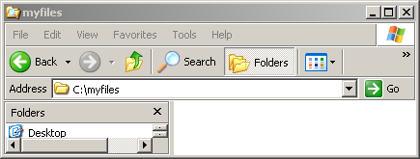
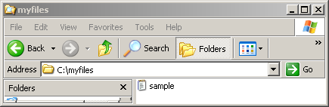
File Handling
#include <stdio.h>
#include <iostream>
using namespace std;
int main()
{
FILE *fp;
fp=fopen("c:\\myfiles\\sample.txt","w"); fclose(fp);
system("pause>0");
return 0;
}

Slide 4
File Handling
FILE *fp;
File pointer points to a structure that contains about the file, such as the location of a buffer, the character position in the buffer, whether the file is being read or written, and whether errors or end of file have occurred.
fp=fopen("c:\\sample.txt","w");

Slide 5
File Handling
fopen is a library function used before reading and writing a file.
FILE *fopen(char *name, char *mode)
name – is a character string containing the name of the file.
mode – a character string, which indicates how one intends to use the file.
“r” open text file for reading
“w” write text file for writing; discard previous contents if any
“a” append; open or create text file for writing at end of file
“r+” open text file for update (i.e. reading and writing)
“w+” create text file for update, discard previous contents if any
“a+” append; open or create text file for update, writing at end

Slide 6
File Handling
Update mode permits reading and writing the same file.
If a file that does not exist is opened for writing or appending, it is created if possible.
Opening an existing file for writing cause the old contents to be discarded, while opening for appending preserves them.
Trying to read a file that does not exist is an error, and there may be other causes of error as well, like trying to read a file when you don’t have permission. If there is any error, fopen will return NULL.

Slide 7
File Handling
fclose is the inverse of fopen, it breaks the connections between the file pointer and the external name that was established by fopen, freeing the file pointer for another file.
int fclose(FILE *fp);

Slide 8


File Handling
#include <iostream>
using namespace std;
int main()
{
FILE *fp;
fp=fopen("c:\\myfiles\\sample.txt","w");
//Check permission if you can write a file
if(!fp)
{
cout << "Cannot open file.\n";
system("pause");
exit(1);
}
//Prints the character ASCII value from 65 to 90 (A-Z) to a file
for(int i=65;i<91;i++)
fputc(i,fp);
fclose(fp);
return 0;
}
Output:
Case 1
Case 2:

Slide 9
File Handling
fputc write the character c to the file and returns the character written, or EOF if an error occurs.
int fputc(int c, FILE *fp);
see also putc

Slide 10
File Handling
Reading from a file
//Get each character from the file and prints to the screen
//until it reach the end of file (EOF)
char c;
while((c = fgetc(fp))!=EOF)
cout << c;
fclose(fp);
system("pause > 0");
return 0;
}
Output:
#include <iostream>
using namespace std;
int main()
{
FILE *fp;
fp=fopen("c:\\myfiles\\sample.txt","r");
if(!fp)
{
cout << "Cannot open file.\n";
system("pause");
exit(1);
}

Slide 11
File Handling
fgetc returns the next character from the stream referred to by file pointer (fp); it returns EOF for end of file or error.
int fgetc(FILE *fp);
see also getc
Appending to a file

Slide 12

File Handling
fputc('\n',fp);
//Prints and append character ASCII value from 97-122 (a-z) to a file
for(int i=97;i<123;i++)
fputc(i,fp);
fclose(fp);
return 0;
}
Before:
After:
#include <iostream>
using namespace std;
int main()
{
FILE *fp;
fp=fopen("d:\\myfiles\\sample.txt","a");
if(!fp)
{
cout << "Cannot open file.\n";
system("pause");
exit(1);
}

Slide 13

File Handling
File Line Input and Output
Writing
fputs("sample string 1\n",fp);
fputs("sample string 2",fp);
fclose(fp);
return 0;
}
Output:
#include <iostream>
using namespace std;
int main()
{
FILE *fp;
fp=fopen("c:\\myfiles\\sample2.txt","w");
if(!fp)
{
cout << "Cannot open file.\n";
system("pause");
exit(1);
}

Slide 14
File Handling
fputs writes a string (which need not contain a newline) to a file it returns EOF if an error occurs, and non negative otherwise.
int fputs(char *line, FILE *fp)

Slide 15
FILE STREAM
Introduction to Computer Programming <number>

Slide 16
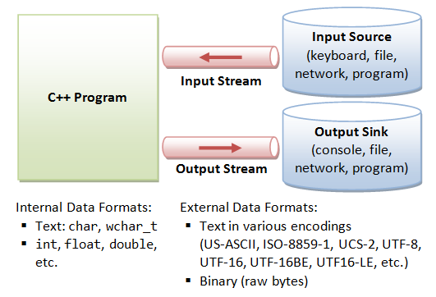
Introduction to Computer Programming <number>

Slide 17
General File I/O Steps
Include the header file fstream in the program.
Declare file stream variables.
Associate the file stream variables with the input/output sources.
Open the file
Use the file stream variables with >>, <<, or other input/output functions.
Close the file.

Slide 18
Using Input/Output Files
stream - a sequence of characters
  interactive (iostream)
    • cin - input stream associated with keyboard.
    cout - output stream associated with display
  file (fstream)
    • ifstream - defines new input stream (normally associated with a file).
    • ofstream - defines new output stream (normally associated with a file).

Slide 19
Stream I/O Library Header Files
Note: There is no “.h” on standard header files : <fstream>
iostream -- contains basic information required for all stream I/O operations
fstream -- contains information for performing file I/O operations

Slide 20
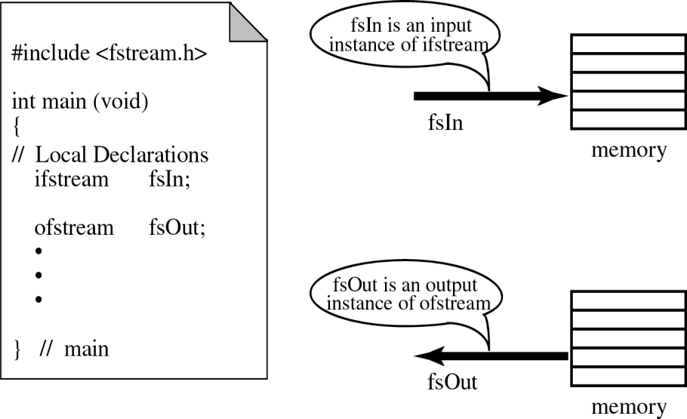
C++ streams
//Add additional header files you use
#include <fstream>
int main ()
{ /* Declare file stream variables such as
the following */
ifstream fsIn;//input
ofstream fsOut; // output
fstream both //input & output
//Open the files
fsIn.open("prog1.txt"); //open the input file
fsOut.open("prog2.txt"); //open the output file
//Code for data manipulation
.
//Close files
fsIn.close();
fsOut.close();
return 0; }

Slide 21





Object and Member Functions
input_stream.open("numbers.txt“)

Slide 22
Open()
Opening a file associates a file stream variable declared in the program with a physical file at the source, such as a disk.
In the case of an input file:
  the file must exist before the open statement executes.
  If the file does not exist, the open statement fails and the input stream enters the fail state
An output file does not have to exist before it is opened;
  if the output file does not exist, the computer prepares an empty file for output.
  If the designated output file already exists, by default, the old contents are erased when the file is opened.

Slide 23
Validate the file before trying to access
First method
Second method
By checking the stream variable;
If ( ! Mystream)
{
Cout << “Cannot open file.\n ”;
}
By using bool is_open() function.
If ( ! Mystream.is_open()) {
Cout << “File is not open.\n ”;
}

Slide 24
File I/O Example: Open the file with validation
First Method (use the constructor)
Second Method ( use Open function)
#include <fstream>
#include <iostream>
using namespace std;
int main()
{
//declare and automatically open the file
ofstream outFile(“fout.txt");
// Open validation
if(! outFile) {
Cout << “Cannot open file.\n ”;
return 1;
}
return 0;
}
#include <fstream>
using namespace std;
int main()
{
//declare output file variable
ofstream outFile;
// open an exist file fout.txt
outFile.open(“fout.txt”);
// Open validation
if(! outFile.is_open() ) {
Cout << “Cannot open file.\n ”;
return 1;
}
return 0;
}
Notes:
This program will create the file fout.txt in the directory from where you are executing it, and will put “Hello, world!” into it.
Here is what every line means:
#include <fstream> - You need to include this file in order to use C++’s functions for File I/O.
In this file, are declared several classes, including ifstream, ofstream and fstream, which are all derived from istream and ostream.
ofstream outFile(“cpp-home.txt”);
ofstream means “output file stream”. It creates a handle for a stream to write in a file.
outFile – that’s the name of the handle. You can pick whatever you want!
(“fout.txt”); - opens the file fout.txt, which should be placed in the directory from where you execute the program. If such a file does not exists, it will be created for you, so you don’t need to worry about that!
Now, let’s look a bit deeper. First, I’d like to mention that ofstream is a class. So, ofstream outFile(“fout.txt”); creates an object from this class. What we pass in the brackets, as parameter, is actually what we pass to the constructor. It is the name of the file. So, to summarize: we create an object from class ofstream, and we pass the name of the file we want to create, as an argument to the class’ constructor. There are other things, too, that we can pass, but I will look into that, later.
outFile<< “Hello World,!”; - “<<” looks familiar? Yes, you’ve seen it in cout <<. This (“<<”) is a predefined operator. Anyway, what this line makes, is to put the text above in the file. As mentioned before, outFile is a handle to the opened file stream. So, we write the handle name, << and after it we write the text in inverted commas. If we want to pass variables instead of text in inverted commas, just pass it as a regular use of the cout <<. This way:
outFile << variablename;
That’s it!
outFile.close(); - As we have opened the stream, when we finish using it, we have to close it. outFile is an object from class ofstream, and this class (ofstream) has a function that closes the stream. That is the close() function. So, we just write the name of the handle, dot and close(), in order to close the file stream!
Notice: Once you have closed the file, you can’t access it anymore, until you open it again.

Slide 25
More Input File-Related Functions
ifstream fsin;
fsin.open(const char[] fname)
  connects stream fsin to the external file fname.
fsin.get(char character)
  extracts next character from the input stream fsin and places it in the character variable character.
fsin.eof()
  tests for the end-of-file condition.

Slide 26
File I/O Example: Reading
Read char by char
Read a line
#include <iostream>
#include <fstream>
int main()
{//Declare and open a text file
ifstream openFile(“data.txt");
char ch;
//do until the end of file
while( ! OpenFile.eof() )
{
OpenFile.get(ch); // get one character
cout << ch; // display the character
}
OpenFile.close(); // close the file
return 0;
}
#include <iostream>
#include <fstream>
#include <string>
int main()
{//Declare and open a text file
ifstream openFile("data.txt");
string line;
while(!openFile.eof())
{//fetch line from data.txt and put it in a string
getline(openFile, line);
cout << line;
}
openFile.close(); // close the file
return 0; }

Slide 27
More Output File-Related Functions
ofstream fsOut;
fsOut.open(const char[] fname)
  connects stream fsOut to the external file fname.
fsOut.put(char character)
  inserts character character to the output stream fsOut.
fsOut.eof()
  tests for the end-of-file condition.

Slide 28
File I/O Example: Writing
First Method (use the constructor)
Second Method ( use Open function)
#include <fstream>
using namespace std;
int main()
{/* declare and automatically open the file*/
ofstream outFile("fout.txt");
//behave just like cout, put the word into the file
outFile << "Hello World!";
outFile.close();
return 0;
}
#include <fstream>
using namespace std;
int main()
{// declare output file variable
ofstream outFile;
// open an exist file fout.txt
outFile.open("fout.txt”);
//behave just like cout, put the word into the file
outFile << "Hello World!";
outFile.close();
return 0;
}
Notes:
This program will create the file fout.txt in the directory from where you are executing it, and will put “Hello, world!” into it.
Here is what every line means:
#include <fstream> - You need to include this file in order to use C++’s functions for File I/O.
In this file, are declared several classes, including ifstream, ofstream and fstream, which are all derived from istream and ostream.
ofstream outFile(“cpp-home.txt”);
ofstream means “output file stream”. It creates a handle for a stream to write in a file.
outFile – that’s the name of the handle. You can pick whatever you want!
(“fout.txt”); - opens the file fout.txt, which should be placed in the directory from where you execute the program. If such a file does not exists, it will be created for you, so you don’t need to worry about that!
Now, let’s look a bit deeper. First, I’d like to mention that ofstream is a class. So, ofstream outFile(“fout.txt”); creates an object from this class. What we pass in the brackets, as parameter, is actually what we pass to the constructor. It is the name of the file. So, to summarize: we create an object from class ofstream, and we pass the name of the file we want to create, as an argument to the class’ constructor. There are other things, too, that we can pass, but I will look into that, later.
outFile<< “Hello World,!”; - “<<” looks familiar? Yes, you’ve seen it in cout <<. This (“<<”) is a predefined operator. Anyway, what this line makes, is to put the text above in the file. As mentioned before, outFile is a handle to the opened file stream. So, we write the handle name, << and after it we write the text in inverted commas. If we want to pass variables instead of text in inverted commas, just pass it as a regular use of the cout <<. This way:
outFile << variablename;
That’s it!
outFile.close(); - As we have opened the stream, when we finish using it, we have to close it. outFile is an object from class ofstream, and this class (ofstream) has a function that closes the stream. That is the close() function. So, we just write the name of the handle, dot and close(), in order to close the file stream!
Notice: Once you have closed the file, you can’t access it anymore, until you open it again.

Slide 29
File Open Mode
Name | Description
ios::in | Open file to read
ios::out | Open file to write
ios::app | All the data you write, is put at the end of the file. It calls ios::out
ios::ate | All the data you write, is put at the end of the file. It does not call ios::out
ios::trunc | Deletes all previous content in the file. (empties the file)
ios::nocreate | If the file does not exists, opening it with the open() function gets impossible.
ios::noreplace | If the file exists, trying to open it with the open() function, returns an error.
ios::binary | Opens the file in binary mode.

Slide 30
File format
In c++ files we (read from/ write to) them as a stream of characters
What if I want to write or read numbers ?

Slide 31
Example writing to file
#include <iostream>
#include <fstream>
using namespace std;
void main()
{
ofstream outFile;
// open an exist outFile.open("number.txt",ios::app);
if (!outFile.is_open())
{ cout << " problem with opening the file ";}
else
{outFile <<200 <<endl ;
cout << "done writing" <<endl;}
outFile.close(); file fout.txt
}

Slide 32


Slide 33

End of Module
Introduction to Computer Programming <number>

Slide 34
SEATWORK
1. Write a C++ program to write numbers divisible by 5 in the range 1 to 100 in a data file NOTES.TXT.
2. Write a function to count the number of blank present in a text file named "OUT.TXT".
Introduction to Computer Programming <number>

Slide 35
Example Reading from file
#include <iostream>
#include <fstream>
#include <string>
#include <sstream>
using namespace std;
void main()
{//Declare and open a text file
ifstream INFile("number.txt");
string line;
int total=0;
while(! INFile.eof())
{
getline(INFile, line);
//converting line string to int
stringstream(line) >> total;
cout << line <<endl;
cout <<total +1<<endl;}
INFile.close(); // close the file
}

Slide 36
